Slide 1
Regression Analysis
Poisson Regression
Nicoleta Serban, Ph.D.
Professor
Stewart School of Industrial and Systems Engineering
Goodness of Fit Assessment: Data Examples

Slide 2

About This Lesson

Slide 3
Data Example 1: High School Awards
Objective: To model and predict the number of awards earned by students at one high school for multiple high schools.
Response Variable: The number of awards earned by students at a high school per year
Predicting Variables:
The type of program in which the student was enrolled, with three levels: 1 = "General", 2 = "Academic" and 3 ="Vocational"; and
The score on the final exam in math.
Acknowledgement: This data example was acquired from the Institute for Digital Research and Education at University of California, Los Angeles.

Slide 4
Goodness-Of-Fit
## Deviance Test for GOF
with(m1, cbind(res.deviance = deviance, df = df.residual,
p = 1- pchisq(deviance, df.residual)))
res.deviance df p
[1,] 189.4496 196 0.6182274
Test for goodness-of-fit:
Using deviance residuals: p-value = 0.61
Do not reject the null hypothesis of good fit.

Slide 5
Residual Analysis
## Residual Plots
res = resid(m1,type="deviance")
par(mfrow=c(2,2))
plot(awardsdata$math,res,ylab="Std residuals",xlab="Math Exam")
abline(0,0,col="blue",lwd=2)
boxplot(res~prog,ylab = "Std residuals")
qqnorm(res, ylab="Std residuals")
qqline(res,col="blue",lwd=2)
hist(res,10,xlab="Std residuals", main="")

Slide 6
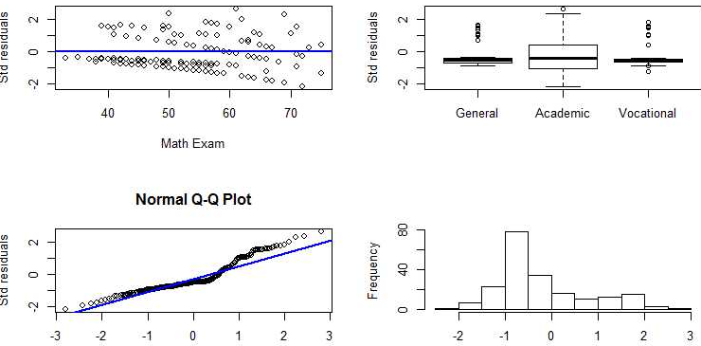
Residual Analysis

Slide 7
Modeling Nonlinear Relationships
## Fit a logistic regression model with math nonlinearly associated to awards count
library(mgcv)
m2 = gam(num_awards ~ prog + s(math), family="poisson", data=awardsdata)
The residuals vs math: downward trend: Consider a non-parametric transformation of ‘math’ predicting variable
Nonparametric association: not specifying the transformation but allowing the data to best identify/fit the transformation
For this example, we do not see an improvement in the fit.

Slide 8

Summary

